Slide 1
A PRESENTATION BY JIBRAN AHMAD

Slide 2

Comprehensive Overview of Microsoft Word:
Purpose
Applications
Use Cases

Slide 3

INTRODUCTION TO MIC R OS OFT WORD
Microsoft Word is a powerful word processing application widely used for creating and editing documents. Its versatility makes it suitable for both personal and professional use. This presentation will provide a comprehensive overview of its purpose, applications, and various use cases.

Slide 4
Why Use Microsoft Word?
Productivity
Word's robust features and tools help you work efficiently, from automatic formatting to real-time collaboration.
Versatility
Word is adaptable to diverse document types, from academic papers to creative writing, making it a versatile choice.
Familiarity
As a widely used and recognized software, Word provides a familiar user experience, simplifying document creation.

Slide 5

PURPOS E OF MICROSOFT WORD
The primary purpose of Microsoft Word is to facilitate document creation and editing. It oﬀers tools for text formatting, spell checking, and grammar correction, enabling users to produce professional-quality documents eﬃciently.

Slide 6

APPLIC ATIONS IN BUS INE S S
In the business environment, Microsoft Word is utilized for creating reports, proposals, and presentations. Its capabilities allow for collaboration and sharing among team members, enhancing productivity and communication.

Slide 7

E DUCAT IONAL US E CAS E S
Educators and students frequently use Microsoft Word for
assignments, thesis writing, and lesson plans. Its features
support research and organization, making it an essential tool in the academic sphere.

Slide 8

P E R S ONAL US E CAS E S
On a personal level, individuals use Microsoft Word for journals, letters, and creative writing. The application provides a platform for self-expression and organization of thoughts in a structured manner.

Slide 9





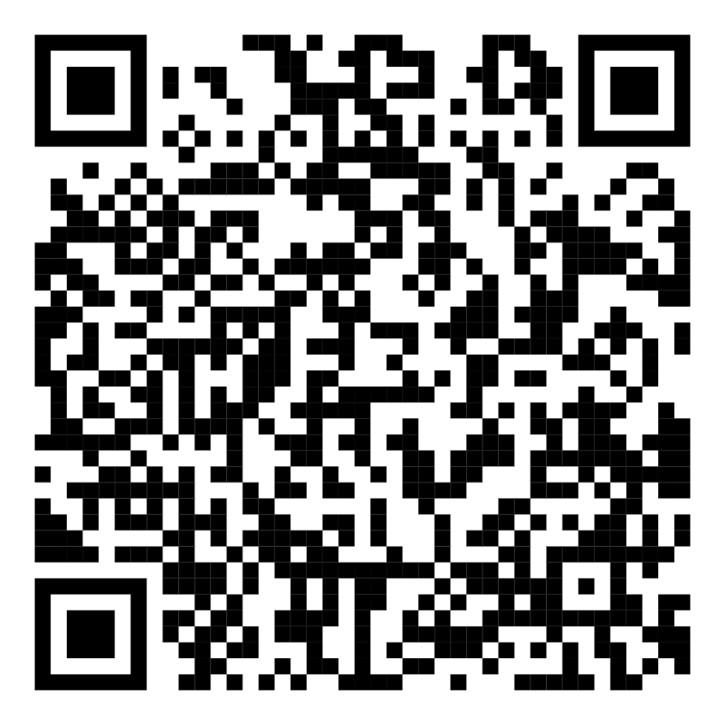
T h a n k s
For Any Questions And Queries,
Reach me out on my socials
Facebook Instagram Linkedin

